Slide 1
RECOMMENDATION SYSTEM USING NAVIE BAYES CLASSIFIER
TEAM MEMBERS :
M.SACHIN BHARATHI(910616205075)
P.VENKATESH PANDIAN(910616205075)
K.A.VISHAL KUMAR(910616205076)
GUIDE :
MR. C.PANDIAN AP(SR.GR)/IT

Slide 2
ABSTRACT
To provide sentimental analysis using Naive Bayes Approach which is better than BOW.
To provide the recommendation meter for the social media videos using sentimental analysis.
To improve the existing algorithm, additional two labels(Over positive and negative) are introduced.
To provide the ability to identify untrained words, similar meaning of untrained word is considered.
The well known algorithm is shaped better with improvements to provide better results.

Slide 3
EXISTING SYSTEM
Sentiment lexicon constructed contains about 6300 words. It was generated manually with SentiWordNet as a baseline.
Each word in lexicon has assigned a value representing sentiment in range of −1 to +1
Polarity Shift problem occurs when there is a negation words like don’t, not occurs etc...
Sentimental score of the comments is not accurate due to miscalculations.

Slide 4
PROPOSED SYSTEM
The proposed system uses supervised learning technique which overcomes the polarity shift problem.
The proposed work includes Naïve Bayes classifier which is one of the major types of probabilistic approaches.
The result shows four different labels (Positive, Negative, Over positive, Over negative).
The proposed system learns the new words even in testing phase by finding the appropriate meaning of the word which is already trained.
The result is enhanced by using four labels and learning new words in testing.

Slide 5
INTRODUCTION
The proposed system is achieved by implementing the Naive Bayes Classification Algorithm.
The positive and negative probability of the reviews are calculated using the model created.
The higher probability is chosen as the label of the review based on the four labels.
The total count of reviews for each label is calculated and stored.
Recommendation engine is finally built based on the count of each labels.

Slide 6
ARCHITECTURE
Training
Machine learning algorithm
label
Feature extractor
input
Feature
Prediction
Feature extractor
Classifier model
input
label

Slide 7
MODULES
DATASET COLLECTION & PREPROCESSING
TEXT CLASSIFICATION
SCORE AGGREGATION.
PERFORMANCE ANALYSIS.

Slide 8
MODULE DESCRIPTION
DATASET COLLECTION & PREPROCESING:
The YouTube comments are the data that needs to be analyzed.
The dataset is collected and stored in the local repository.
Since the dataset consists of many information, unwanted information for classification is being removed. This includes :
    Removal of Stop words
    Punctuations & symbols Removal
    Removal of numerical values

Slide 9
MODULE DESCRIPTION
TEXT CLASSIFICATION :
The training is done with the provided training set and a feature set is created.
Testing review is separated into single words or tokens.
Based on the occurrences of the tokens in the feature set, positive and negative probability of the review is calculated.
The higher probability is chosen as the label of the review based on the four label.
Classification is done by using Naïve Bayes Classifier.

Slide 10
MODULE DESCRIPTION
NAVIE BAYES ALGORITHM :
TRAINING DATA: TESTING DATA :
  The product is nice.(1) - The watch is good.
  The movie is good.(1)
  Very bad movie.(0)
Training data is splitted into single words as :
WORDS | POSITIVE | NEGATIVE
The | 2 | 0
Product | 1 | 0
Nice | 1 | 0
Movie | 1 | 1
Good | 1 | 0
Very | 0 | 1
Bad | 0 | 1

Slide 11
MODULE DESCRIPTION
NAVIE BAYES ALGORITHM :
The testing data is splitted to calculate both positive probability and negative probability.
p(the/positive) = 2 +1 / 7 + 6 = 3/13 = 0.23
P(watch/positive) = 0 + 1 / 7 + 6 = 1 /13 = 0.076
P(nice/positive) = 1 + 1 / 7 + 6 = 2 /13 = 0.15
Prior Probability = 2/3 = 0.66
Posterior Probability = Likelihood * Prior Probability.
Posterior Probability(positive)= 0.026 * 0.66 = 0.017
Positive Probability = 0.017

Slide 12
MODULE DESCRIPTION
NAVIE BAYES ALGORITHM :
p(the/negative) = 0 + 1 / 7 + 3 = 1/10 = 0.10
P(watch/negative) = 0 + 1 / 7 + 3 = 1 /10 = 0.10
P(nice/negative) = 0 + 1 / 7 + 3 = 1 /10 = 0.10
Prior Probability = 1/3 = 0.33
Posterior Probability = Likelihood * Prior Probability.
Posterior Probability(negative)= 0.001 * 0.33 = 0.0033
Negative Probability = 0.0033
0.017(positive probability) > 0.0033 (negative probability)
So, the given review is positive.

Slide 13
MODULE DESCRIPTION
SCORE AGGREGATION :
To build a recommendation system for the reviews, we made a method that gives score for each labels to calculate the recommendation percentage.
Positive review = 1, Negative review = 0, Over Positive = 1.5, Over Negative = - 0.5
By considering the unique score for each labels, it is efficient to develop a recommendation system.
Recommendation system built using this method finally results in recommendation percentage of the video.

Slide 14
MODULE DESCRIPTION
PERFORMANCE ANALYSIS :
The new words in the testing set are even added to the feature set, which makes the model to classify the label efficiently.
The classification with only two labels ( positive, negative) gives a sentimental score for the dataset.
The classification extended with four labels ( positive, negative, over positive, over negative) improves the model and gives the better sentimental score.
Thus the normal Naive Bayes is improved by considering four labels instead of two labels.

Slide 15
CONCLUSION
The total number of positive and negative reviews in the given review set is calculated using Naïve Bayes Classifier.
Each labels has a unique score which is used to built the recommendation percentage.
Finally, A Recommendation System is built for the given dataset which results in recommendation meter of the video.
Using four labels improves the accuracy of the model and gives accurate recommendation value.

Slide 16
FUTURE ENHANCEMENT
Usage of emoji can be analyzed and considered in action to improve the results.
Misspelling of the words can be trained correctly to improve the model.
Usage of words in short form (e.g : good as gud) can be properly understood to improve the training.
Analyzing the complex comments(This is good bad and nice film ) could perform better.
Sarcastic comments should be identified and trained as negative rather than considering positive.

Slide 17
REFERENCES
1]”SentiFul: A Lexicon for Sentiment Analysis” Alena Neviarouskaya, Helmut Prendinger, and Mitsuru Ishizuka, Member, IEEE Transations on Affective Computing, vol 2, no. 1, Jan-Mar 2011
[2] “Sentiment Classification using Machine Learning Techniques” Bo Pang and Lillian Lee Department of Computer Science Cornell University Ithaca, NY 14853 USA Shivakumar Vaithyanathan IBM Almaden Research Center 650 Harry Rd. San Jose, CA 95120 USA
[3]A. Abbasi, S. France, Z. Zhang, and H. Chen, “Selecting attributes for sentiment classification using feature relation networks,” IEEE Trans. Knowl. Data Eng., vol. 23, no. 3, pp. 447–462, Mar. 2011.
[4] “Sentiment Analysis of Blogs by Combining Lexical Knowledge with Text Classification” Prem Melville IBM T.J. Watson Research Ctr. P.O. Box 218 Yorktown Heights, NY.
[5] “Effects of Adjective Orientation and Gradability on Sentence Subjectivity” Vasileios Hatzivassiloglou Department of Computer Science Columbia University New York, NY 10027, Janyce M. Wiebe Department of Computer Science New Mexico State University Las Cruces, NM 88003.

Slide 18
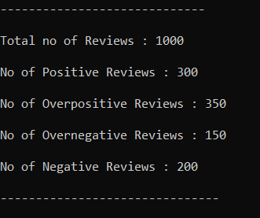
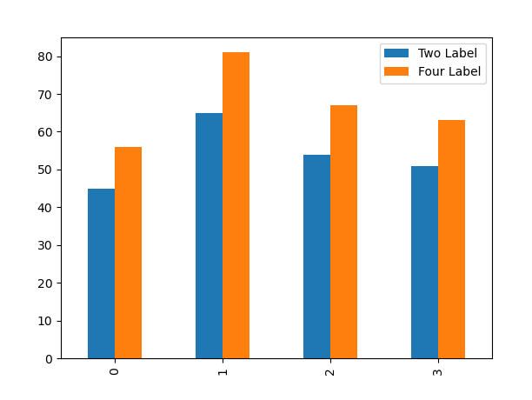
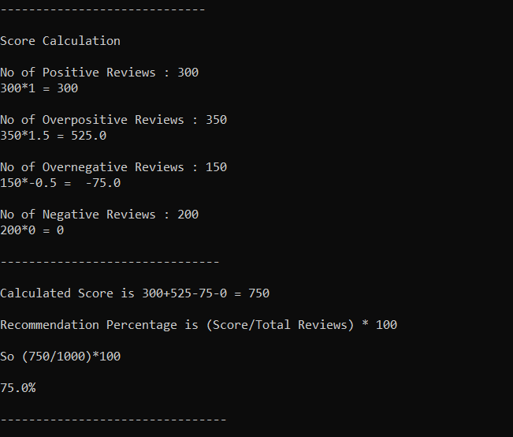
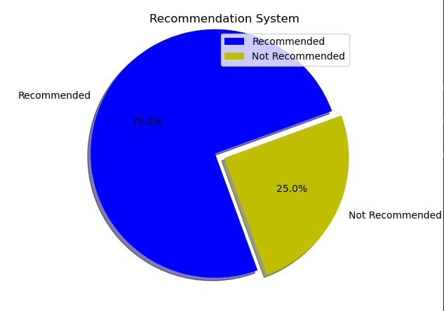
SCREENSHOT

Slide 19
THANK YOU

